Slide 1
도토리는버스둘태워야서로맛

Slide 4
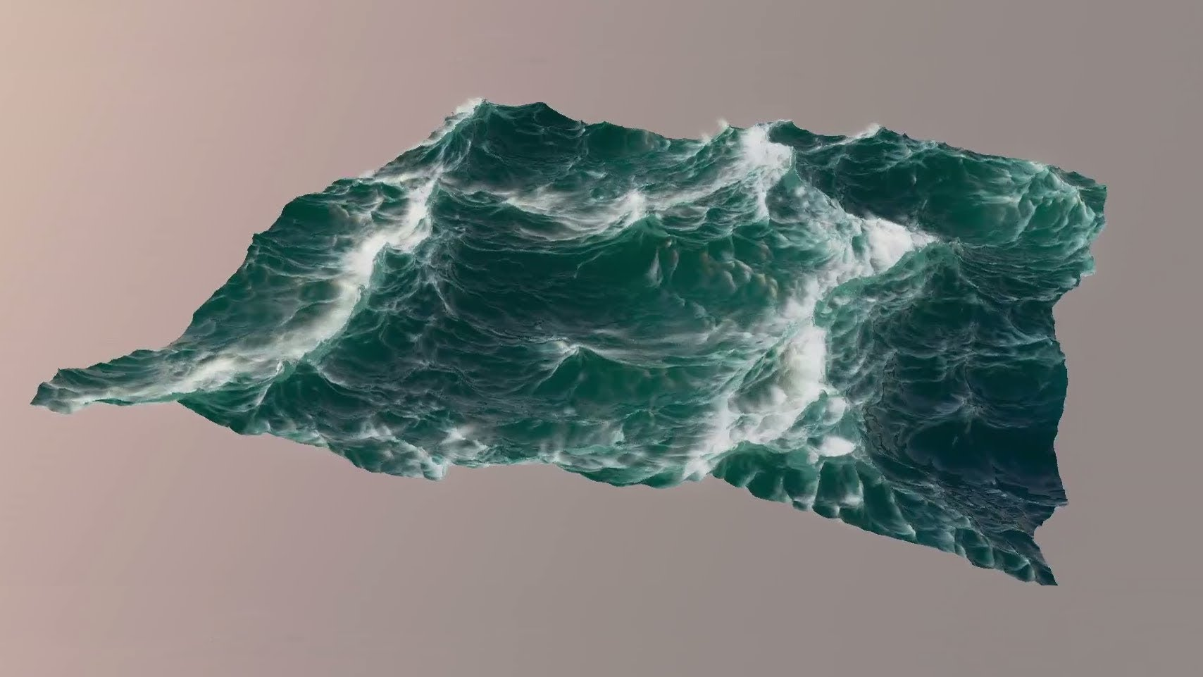
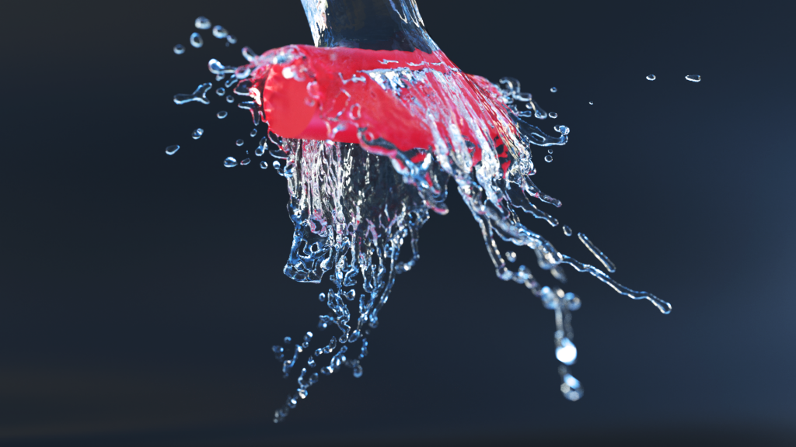
Fluid simulation

Slide 5
Fluid simulation
Simulating fluid motion on computer
Very intensive computational load
Since colligative description of fluid is not useful at all simulating the motion of fluid
Need to approach in micro level

Slide 6
Fluid model
Assume fluid is made of particles
Simulating fluid by simulating independent particles

Slide 7
Fluid model - particle
Intuitively, it is reasonable to regard each particle as a rigid body (water is incompressible fluid)
But it means we need to calculate collisions between particles
→ Nasty!
Need a collision-less model

Slide 8
Fluid model - particle
Each particle is a point mass (has no volume)
Each particle has two simple physical properties
Position
Velocity
Every particle interacts (Important!)
Repulsion when they are too close (Radius of particle)
Attraction when they are in some range (Surface tension of particle)
No interaction when they are too far (Locality of particle)
Friction when they are moving in different directions (Viscosity of particle)

Slide 9
Fluid model – particle interaction
Repulsion and attraction
Are just functions of distance between two particles
Friction
Is a function of difference of velocities of two particles

Slide 10
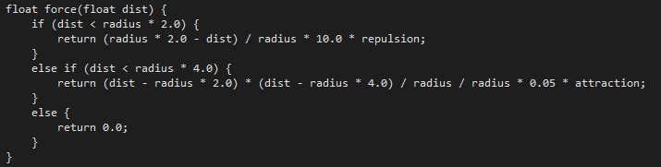
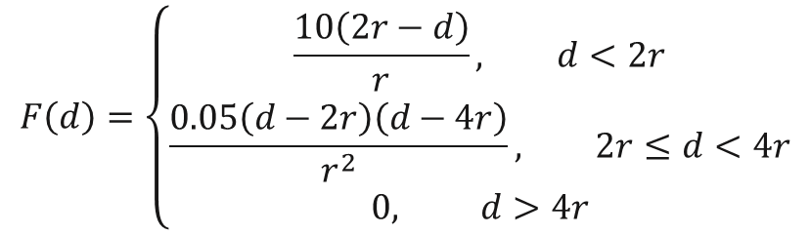
Fluid model – particle interaction
Very simple.
$$F\left(d\right)=\left\{\begin{aligned}\frac{10\left(2r−d\right)}{r}, d<2r \\ &\frac{0.05\left(d−2r\right)\left(d−4r\right)}{r^{2}}, 2r≤d<4r \\ 0, d>4r\end{aligned}\right.$$
Why? Don’t ask… it is just a result of try-and-error

Slide 11
First trial
Interaction involves 2 particles
O(n^2) brute forcing

Slide 12
Evil O(n^2) brute forcing
Veeeeeeeeeeeeeeeeeeeeeeeeeeeeery slow
At most 1000 particles
Even with GPU processing!!
Does not really look like fluid

Slide 13

Optimization
We don’t need to consider particles they are too far apart
The last line of force equation tells us that…….
$$F\left(d\right)=\left\{\begin{aligned}\frac{10\left(2r−d\right)}{r}, d<2r \\ &\frac{0.05\left(d−2r\right)\left(d−4r\right)}{r^{2}}, 2r≤d<4r \\ 0, d>4r\end{aligned}\right.$$

Slide 14
Neighbor group
Divide space into small grid cubes
Calculate interaction force only between nearby cubes

Slide 15
Neighbor group
But it is very tricky to classify particles into some groups, using GPU processing
I will not explain the details now
7 minute is so short…
Maybe in the final presentation?

Slide 16
Anyway
Computational load is lowered to O(n).
The number of particles is dramatically increased!

Slide 17
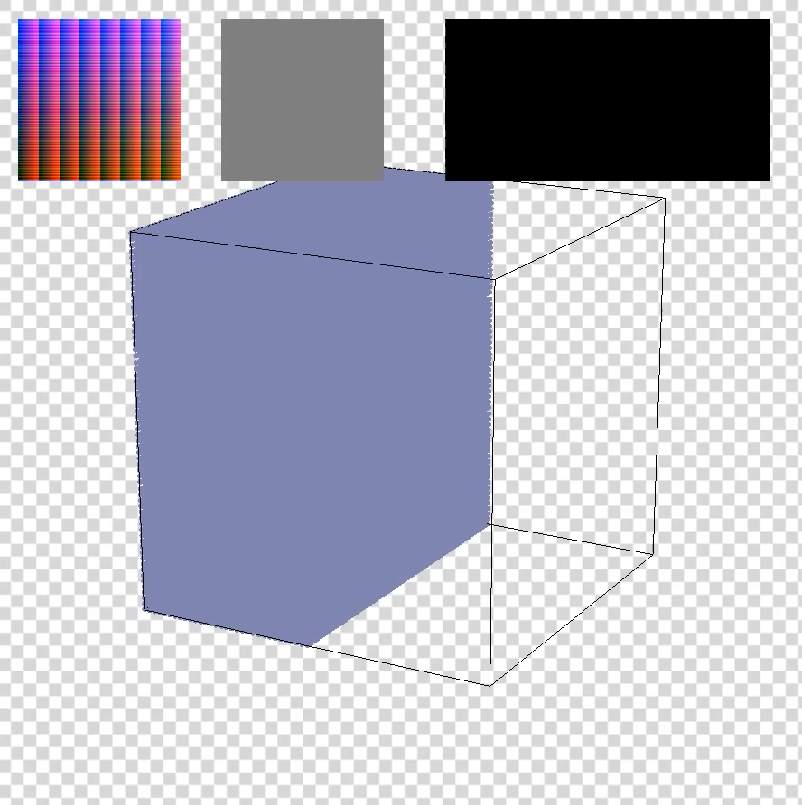
Demo
131072 particles
E3-1231v3
GTX980Ti
16GB DDR3

Slide 18
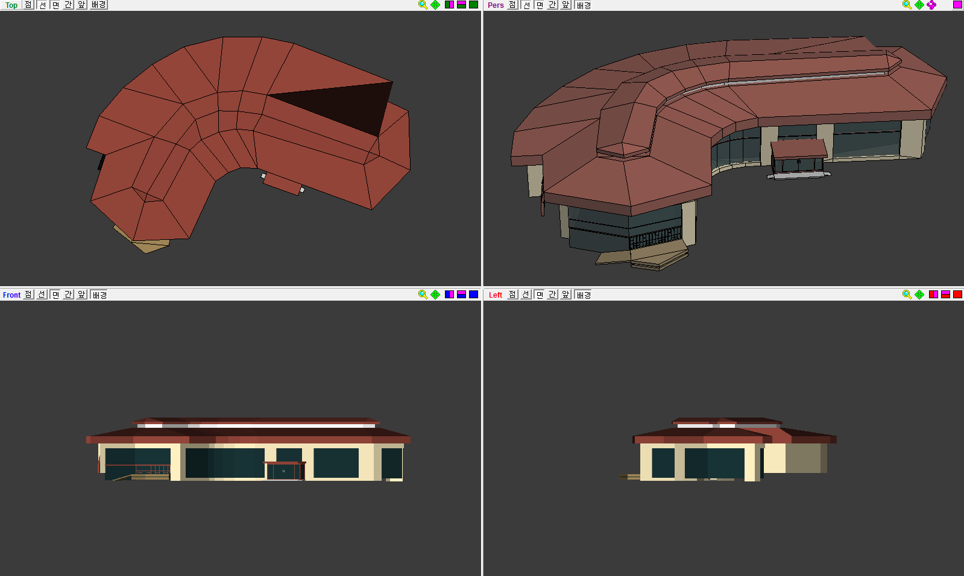
Modeling – Metasequoia

Slide 19
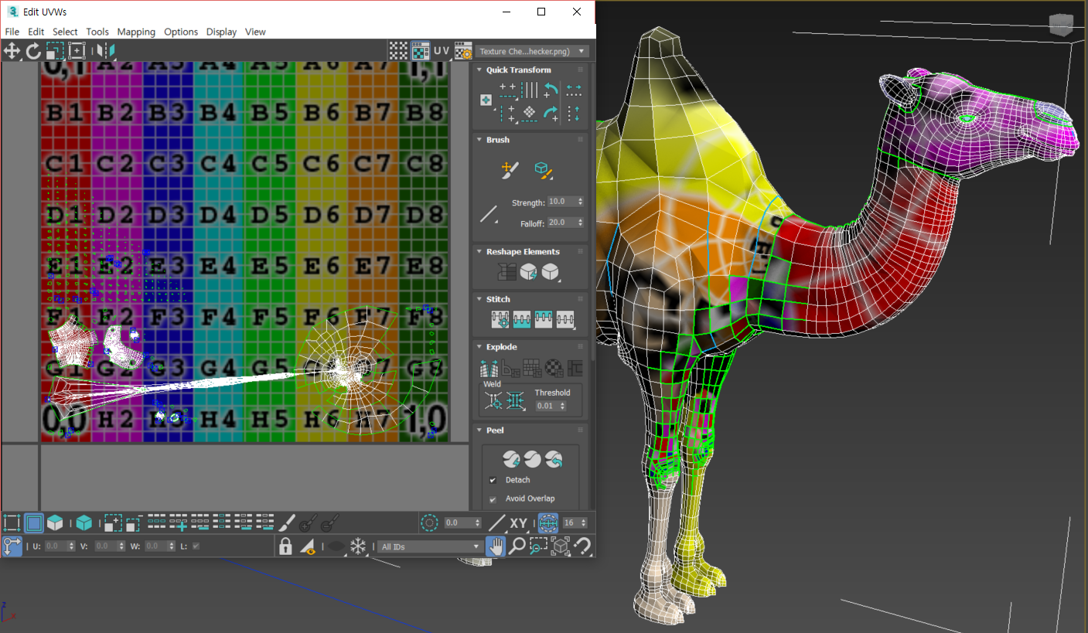
Texture – 3DS MAX

Slide 20
Schedule
~06.04
Finishing modeling and texture, normal mapping
Improving fluid model
~06.13
Optimizing fluid model
Writing final report / Preparing for presentation
06.14
Final presentation

Slide 21
Q&A

Slide 22
Thank you for listening

